Slide 1


GE Cybersecurity Software Development
Ludiana Atnafu
Madison Goodwin
Shawn Huesman
Wie Lie Sie
William St. Onge

Slide 2

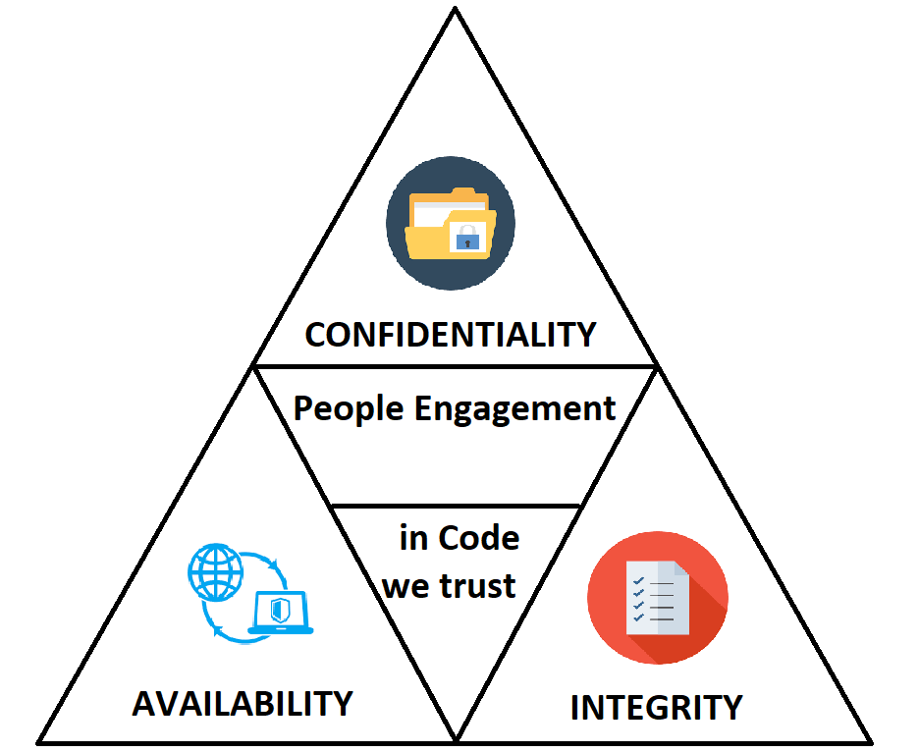
Notes:
Content slide

Slide 3
Product Vision
SECURE, EFFICIENT & CONVENIENT SOFTWARE THAT PROTECTS USERS AND REDUCES WORKLOAD

Slide 4
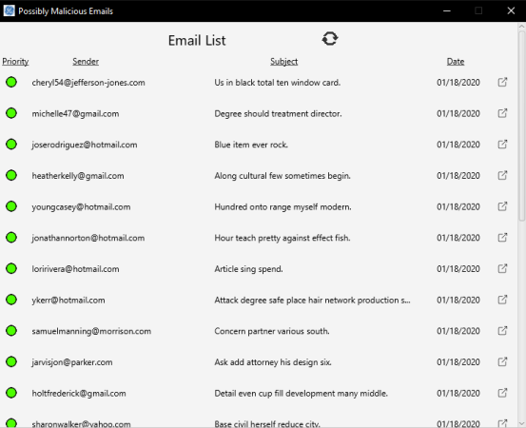
Product Platform
DESKTOP APPLICATION

Slide 5
Product RoadMap
Review project specifications and requirements.
Role assignments.
“Customer” interviews.
Drawing boards (brainstorming, mind mapping).
Code development.
Simulation and Testing.
Customer review.
Adjustments and improvement.

Slide 6
Human Vulnerability
Technical solutions alone are insufficient to protect phishing attacks (reference [1], [2], [3], [4], [5])
IDENTIFY | REPORT | RESPONSE | RECOVER
Identify phishing emails and understand malicious attacks | Report suspicious emails to cybersecurity team | Response to cybersecurity analysis report | Recover any emails after being marked safe

Slide 7
Adaptability
Web Application migration from Desktop Application
SQL migration from NoSQL

Slide 8
References
[1] Wilson, C. and D. Argles. The fight against phishing: Technology, the end user and legislation. in Information Society (i-Society), 2011 International Conference on. 2011: IEEE.
[2] Kirlappos, I. and M.A. Sasse, Security education against phishing: A modest proposal for a major rethink. IEEE Security and Privacy Magazine, 2012. 10(2): p. 24-32.
[3] Abawajy, J.H., K. Thatcher, and T.-h. Kim. Investigation of stakeholders commitment to information security awareness programs. in Information Security and Assurance, 2008. ISA 2008. International Conference on. 2008: IEEE.
[4] Aloul, F.A., The Need for Effective Information Security Awareness. Journal of Advances in Information Technology, 2012. 3(3): p. 176- 183.

Slide 9
APPLICATION TUTORIAL
Notes:
Content slide

